Slide 1
CSI ZG515/ SS ZG515 Data Warehousing
Swarna Chaudhary

Slide 2
Real-Time Data Warehousing (RTDWH) &
Current trends in DWH

Slide 3
Topics
What is Real-Time Data Warehousing (RTDWH)?
Challenges with RTDWH and Solutions
ELT vs ETL
Big Data
Hadoop/Map-Reduce
Structured DW vs Unstructured

Slide 4
Real Time vs Near-Real Time vs Batch Processing
Real time processing requires a continual input, constant processing, and steady output of data.
Example is data streaming, radar systems, and bank ATMs, where immediate processing is crucial to make the system work properly.
Spark is a great tool to use for real-time processing.
Near real-time processing is when speed is important, but processing time in minutes is acceptable in lieu of seconds. Examples are
Background Processes: A social media platform has a variety of background processes that inspect user generated content for policy violations within a few minutes. In other words, content is posted in real-time but is removed in near real-time if an algorithm decides it violates the firm's policies.
Communications : A messaging app usually delivers messages within a few seconds. This can be compared to voice communications that require real-time data
Analytics: A web analytics tool allows users to view current traffic to a website with a delay of a few minutes.

Slide 5
Real Time vs Near-Real Time vs Batch Processing
Batch processing is even less time-sensitive than near real-time. In fact, batch processing jobs can take hours, or perhaps even days.
Batch processing involves three separate processes. First, data is collected, usually over a period of time. Second, the data is processed by a separate program. Thirdly, the data is output.
Examples of uses for batch processing include payroll and billing activities

Slide 6
Introduction
Traditionally DWs do not contain today's data. They are usually loaded with data from operational systems at most weekly or in some cases nightly, but are in any case a window on the past.
The fast pace of business today is quickly making these historical systems less valuable to the issues facing managers and government officials in the real world.
Some Examples:
Morning sales on the east coast will affect how stores are stocked on the west coast.
Airlines and government agencies need to be able to analyze the most current information when trying to detect suspicious groups of passengers or potentially illegal activity
Fast-paced changes in the financial markets may make the personalized suggestions on a stockbroker's website obsolete by the time they are viewed.
Reference: Real-Time Data Warehousing: Challenges and Solutions by Justin Langseth

Slide 7
Introduction
As today's decisions in the business world become more real-time, the systems that support those decisions need to keep up.
It is only natural that DW/BI systems quickly begin to incorporate real-time data.
DW/BI applications are designed to answer exactly the types of questions that users would like to pose against real-time data.
They are able to analyze vast quantities of data over time, to determine what is the best offer to make to a customer, or to identify potentially fraudulent, illegal, or suspicious activity.

Slide 8
Introduction
Today’s integration project teams face the daunting challenge that, while data volumes are exponentially growing, the need for timely and accurate business intelligence is also constantly increasing
Batches for DW loads used to be scheduled daily to weekly; today’s demand information that is as fresh as possible
The value of this real-time data decreases as it gets older
Latency of data integration is essential for the business value of the DW
At the same time the concept of “business hours” is vanishing for a global enterprise, as data warehouses are in use 24 hours a day, 365 days a year

Slide 9
Introduction
This means that the traditional nightly batch windows are becoming harder to accommodate, and interrupting or slowing down sources is not acceptable at any time during the day.
Finally, integration projects have to be completed in shorter release timeframes, while fully meeting functional, performance, and quality specifications on time and within budget
Real-time data warehousing requires a solid approach to data integration and most importantly, the ability to transform and filter data on-the-fly to ensure it meets the needs of its different users

Slide 10
Challenge #1: Enabling Real-time ETL
One of the most difficult parts of building any data warehouse is the process of extracting, transforming, cleansing, and loading the data from the source system.
Performing ETL of data in real-time introduces additional challenges. Almost all ETL tools and systems, assume that the data becomes available as some sort of extract file on a certain schedule, usually nightly, weekly, or monthly.
Then the system transforms and cleanses the data and loads it into the data warehouse.
This process typically involves downtime of the data warehouse, so no users are able to access it while the load takes place.
Since these loads are usually performed late at night, this scheduled downtime typically does not inconvenience many users.
When loading data continuously in real-time, there can't be any system downtime. The heaviest periods in terms of data warehouse usage may very well coincide with the peak periods of incoming data. The requirements for continuous updates with no warehouse downtime are generally inconsistent with traditional ETL tools and systems.

Slide 11
Challenge #2: Modeling Real-time Fact Tables
Data warehouse that has all of its data aggregated at various levels based on a time dimension needs to consider the possibility that the aggregated information may be out of synch with the real-time data.
Also some metrics such as month-to-date and week-to-date may behave strangely with a partial day of data that continuously changes.
The main issue regarding modeling however revolves around where the real-time data is stored, and how best to link it into the rest of the data model.

Slide 12
Challenge #3: OLAP Queries vs. Changing Data
OLAP and Query tools were designed to operate on top of unchanging, static historical data.
Since they assume that the underlying data is not changing, they don't take any precautions to ensure that the results they produce are not negatively influenced by data changes concurrent to query execution.
In some cases, this can lead to inconsistent and confusing query results.
Relational OLAP tools perform data analysis operations by issuing multi-pass SQL.
A multi-pass SQL statement is made up of many smaller SQL statements that sequentially operate on a set of temporary tables.
Reference: Real-Time Data Warehousing: Challenges and Solutions by Justin Langseth

Slide 13
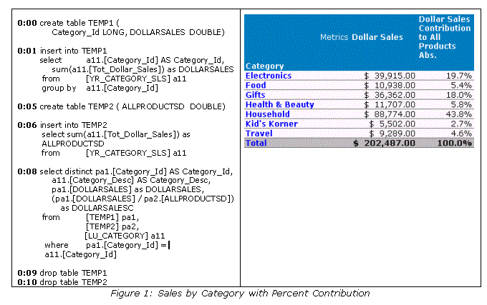

Slide 14
Challenge #4: Scalability & Query Contention
The issue of query contention and scalability is the most difficult issue facing organizations deploying real-time data warehouse solutions.
Data warehouses were separated from transactional systems in the first place because the type of complex analytical queries run against warehouses don't "play well" with lots of simultaneous inserts, updates, or deletes.
Given a fixed amount of data, the number of users on the system is proportional to query response time. Lots of concurrent usages causes reports to take longer to execute.
While this is still true in a real-time system, the additional burden of continuously loading and updating data further strains system resources.

Slide 15
Solutions
Fortunately, there are new tools on the market that specialize in real-time ETL and data loading. There are also ways of modifying existing ETL systems to perform real-time or near real-time warehouse loading.

Slide 16
Real-Time FT Partitions
Assuming that an application requires a true-real time DW, the simplest approach is to continuously feed the data warehouse with new data from the source system
This can be done by either directly inserting or updating data in the warehouse fact tables, or by inserting data into separate fact tables in a real-time partition

Slide 17
Kimball’s Approach to RTDWH
Real-Time Partitions (Generation 2)
Separate real-time fact table is created whose grain & dimensionality matches that of the corresponding FT in the static (nightly loaded) DW
Real-time FT contains only current day’s facts (those not yet loaded into the static FT)
Each night, the contents of RTFT are written to the static FT and the RTFT is purged, ready to receive the next day’s facts

Slide 18
Near Real-Time ETL
Simply increasing the frequency of the existing data load may be sufficient.
A data load that currently occurs weekly can perhaps be performed instead daily, or twice a day
A daily data load could be converted to an hourly data load
While not real-time, near-real time may be a good inexpensive first step

Slide 19
Trickle & Flip
The "Trickle & Flip" approach helps avert the scalability issues associated with querying tables that are being simultaneously updated
Instead of loading the data in real-time into the actual DW tables, the data is continuously fed into staging tables that are in the exact same format as the target tables
Depending on the data modeling approach being used the staging tables either contain a copy of just the data for the current day, or for smaller fact tables can contain a complete copy of all the historical data
Then on a periodic basis the staging table is duplicated and the copy is swapped with the fact table, bring the DW instantly up-to-date
Depending on the characteristics of how this swap is handled by the particular RDBMS, it might be advisable to temporally pause the OLAP server while this flip takes place so that no new queries are initiated while the swap occurs.

Slide 20
External Real-Time Data Cache (RTDC)
All of the solutions discussed so far involve the DW’s underlying database taking on a lot of additional load to deal with the incoming real-time data, and making it available to warehouse users
The best option in many cases is to store the real-time data in an external real-time data cache (RTDC) outside of the traditional DW, completely avoiding any potential performance problems and leaving the existing warehouse largely as-is.
The RTDC can simply be another dedicated database server (or a separate instance of a large database system) dedicated to loading, storing, and processing the real-time data
Applications that either deal with large volumes of real-time data (hundreds or thousands of changes per second), or those that require extremely fast query performance, might benefit from using an in-memory database (IMDB) for the RTDC
Such IMDBs are provided by companies such as Angara, Cacheflow, Kx, TimesTen, and InfoCruiser

Slide 21
RTDC & JIM
There is a class of applications which tend to share two or more of the following characteristics:
Require true real-time data (not near-real-time)
Involve rapidly-changing data (10-1000 transactions per second)
Need to be accessed by 10s, 100s, or 1000s of concurrent users
Analyze real-time data in conjunction with historical information
Involve complex, multi-pass, analytical OLAP queries

Slide 22
RTDC & JIM
These applications require the best aspects of a traditional DW such as access to large amounts of data, analytical depth, and massive scalability
They also require the access to real-time data and processing speed provided by a real-time data cache.
Necessary to use a hybrid approach.
The real-time information sits in RTDC and the historical information sits in a DW, and the two are efficiently linked together as needed. This can be accomplished by an approach known as just-in-time information merging (JIM)

Slide 23
ETL VS ELT

Slide 24
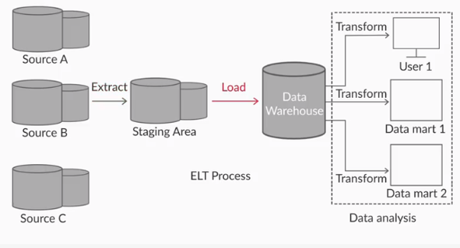
ELT

Slide 25
ELT
Data is extracted from the various data sources into the "Staging area". This staging area is a temporary data store where data integrity and business rule checks are done and appropriate corrections are made. This data is then directly loaded into the Data Warehouse where the data is stored in the form of Fact and Dimension tables. Transformation stage of ELT process is performed over data stored in the Data
An important thing to note is that the Extract and Load stages are independent of the Transform stage.
Since Transformation of data occurs at the time of querying the data, only that data is transformed which is queried by the user. Thus, all data extracted from the data sources need not pass through the transformation stage in the case of ELT process.
ELT process is a commonly used data ingestion process for loading data into something called Data Lake,

Slide 26
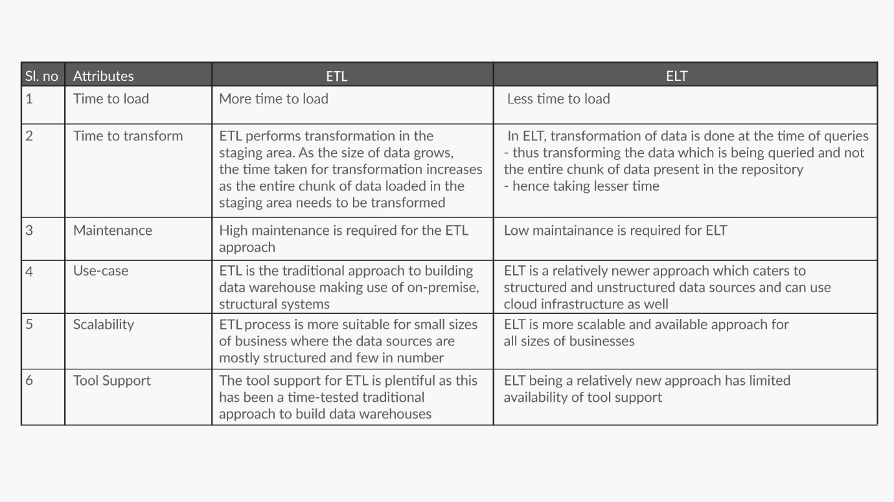
ETL vs ELT

Slide 27
Data
Structured data refers to kinds of data with a high level of organization, such as information in a relational database or spreadsheets. It has a well-defined format wherein one can store the data. It refers to the data that resides in a fixed field within a record or file.
Unstructured Data refers to any data that does not resides in traditional row-column database. Unstructured data includes files such as text files or multimedia content (e.g. emails, videos, photos, web pages, etc). Unstructured data is not relational and does not fit into any pre-defined data models.
Semi-Structured Data: In addition to structured and unstructured data, there's also a third category: semi-structured data. Semi-structured data is information that doesn't reside in a relational database but that does have some organizational properties that make it easier to analyze.
Examples of semi-structured data might include XML documents and NoSQL databases.

Slide 28
Big Data
Definition:
According to SAS, Big data is a term that describes a large volume of data – both structured and unstructured – that inundates a business on a day-to-day basis. But it is not the amount of data that is important, it is what organizations do with the data that matters. Big data can be analyzed for insights that lead to better decisions and strategic business moves.
Exceeds the processing capacity of conventional database systems
It consists of a variety of data such as semi-structured, structured, and unstructured data
Audio, video, text, logs,etc.
Data flows at a very high speed

Slide 29
3V’s of Big Data
Big Data is mainly associated with unstructured data and is defined in 3V’s.
Volume: Organizations collect data from a variety of sources, including business transactions, social media, sensor data, audio, video etc. In the past, storing it would’ve been a problem – but new technologies (such as Hadoop) have eased the burden.
Velocity: Data streams in at an unprecedented speed and must be dealt with in a timely manner. RFID tags, sensors and smart metering are driving the need to deal with torrents of data in near-real time.
Variety. Data comes in all types of formats – from structured, numeric data in traditional databases to unstructured text documents, email, video, audio, stock ticker data and financial transactions.

Slide 30
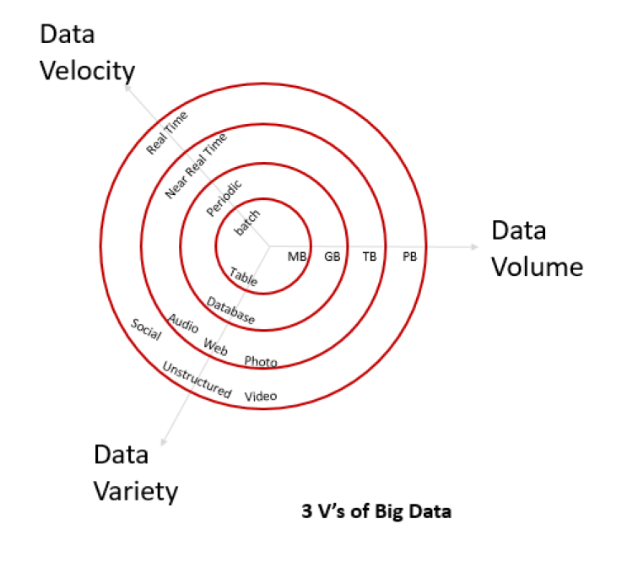
3V’s of Big Data

Slide 31
Unstructured Data

Slide 32
Some interesting articles on Big Data
The keyword in Data Science is not “Data”; it is “Science”
Data generated Every Minute On Social Media?

Slide 33
Hadoop
Hadoop is an Apache open source framework written in java that allows distributed storage and processing of large datasets on clusters of commodity hardware.
It is a distributed system
It consists of:
HDFS (Hadoop Distributed File System)
Middleware such as MapReduce to parallelise and execute programs on a cluster of machines.
Hadoop also follows the master-slave architecture. The master is known as the NameNode and the slaves are referred to as DataNodes.
Reasons to use Hadoop for Data Science
Hadoop vs RDBMS

Slide 34
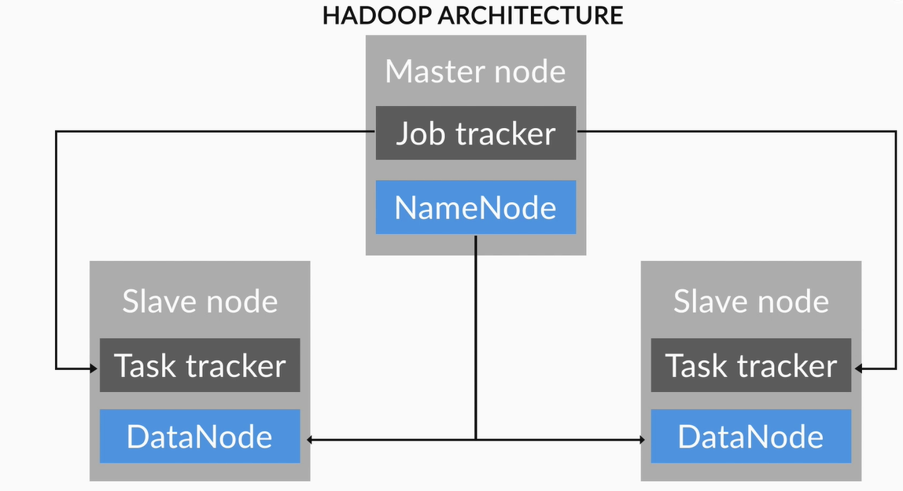
HDFS Architecture

Slide 35
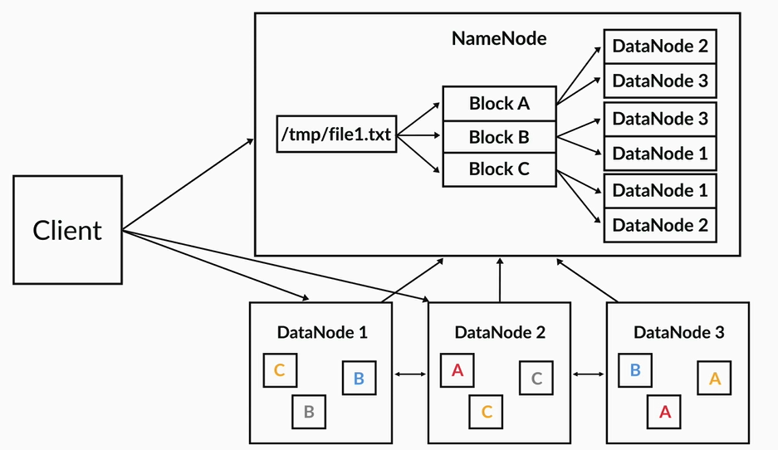
HDFS Architecture

Slide 36
MapReduce
MapReduce is a batch-oriented distributed computing framework that utilises the data-parallel programming model.
The MapReduce framework breaks down the large task into small map and reduce tasks, and these map tasks are run in parallel at the DataNodes storing the input data.
Each map function takes a key-value pair that represents a record from the input data source and produces some intermediate key-value pairs as the output.
The intermediate key-value pairs become the input to the reduce tasks, which then give the final output after performing the reduce function on them.
Map job (done by Mapper class), takes a set of data and converts it into another set of data, where individual elements are broken down into tuples (key/value pairs). The reduce job (done by Reducer class) takes the output from a map as input and combines those data tuples into a smaller set of tuples.

Slide 37
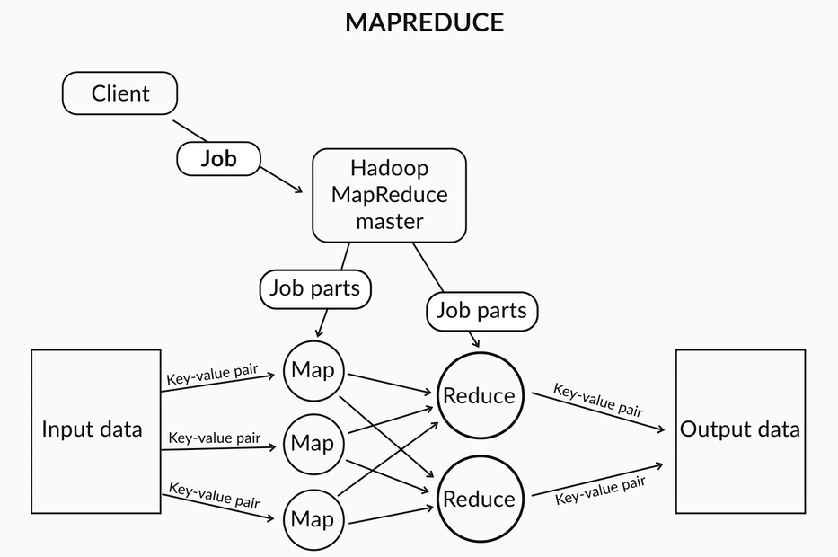
MapReduce

Slide 38
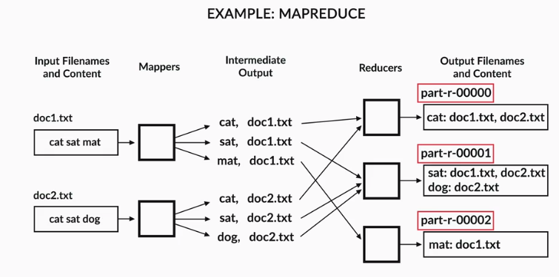
MapReduce: Example

Slide 39
Key Features of Hadoop
Open-source: Apache Hadoop is an open source, i.e. its code can be modified according to business requirements.
Distributed Processing: Data is processed in parallel on cluster of nodes and enables High throughput data access.
Data Locality: A computation requested by an application is much more efficient if it is executed near the data it operates on. This is especially true when the size of the data set is huge. This minimizes network congestion and increases the overall throughput of the system. When client submits the algorithm, this algorithm is moved to data in the cluster rather than bringing data to the location where algorithm is submitted and then processing it. Result set of all local servers is consolidated.
High Availability: Data is highly available and accessible despite hardware failure due to multiple copies of data. If a machine or few hardware crashes, then data will be accessed from other path.
Scalability: Hadoop is highly scalable in the way new hardware can be easily added to the nodes. It also provides horizontal scalability which means new nodes can be added on the fly without any downtime.
Runs on commodity hardware: Instead using a powerful and expensive server, Hadoop uses a cluster of multiple inexpensive servers for computing large datasets. No specialized machine are needed for it.
Highly fault-tolerant: By default 3 replicas of each block is stored across the cluster in Hadoop. So if any node goes down, data on that node can be recovered from other nodes.
Large Data Sets: Hadoop is used to handle Big Data such as structured, semi-structured, and particularly unstructured data.

Slide 40
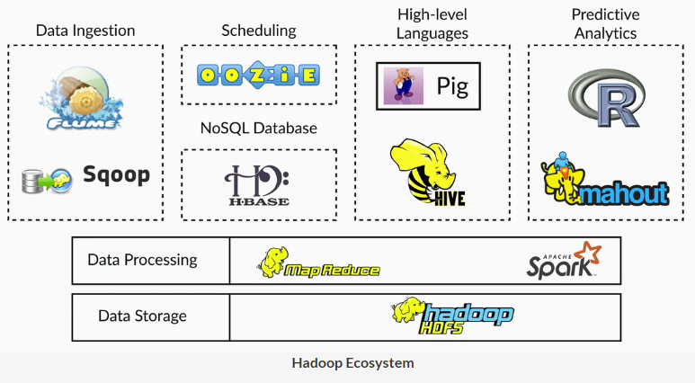
Hadoop Ecosystem

Slide 41
Hadoop Ecosystem
Flume: It is a distributed framework that efficiently collects, aggregates, and moves large amounts of unstructured and semi-structured streaming data into HDFS.
R: This is a programming language used to derive insights from big data. It is used for a variety of statistical techniques including linear and non-linear modelling, time series analysis, classification, clustering, etc. for mining information from raw data. The commonly used methods to integrate Hadoop and R are RHadoop and RHive.
Apache Mahout: It provides an implementation of distributed and scalable machine learning algorithms focused on collaborative filtering, clustering, and classification.
Oozie: A workflow management system that helps in defining and monitoring a sequence of tasks on a Hadoop cluster.
Apache Spark: A framework for real-time data analytics in a distributed computing environment that increases the speed of data processing over MapReduce frameworks by executing computations in-memory. This extends the MapReduce model to efficiently use more types of computations, which include iterative queries and stream processing
Sqoop: An application that provides a command-line interface for transferring data between Hadoop and relational databases.
Hive: A data warehouse that provides an SQL-like interface to query databases and filesystems integrated with Hadoop
HBase: it is an open source NoSQL database that runs on HDFS. It is Column oriented key-value data store

Slide 42
Data Warehouse
Wikipedia, defines Data Warehouses as:
“…central repositories of integrated data from one or more disparate sources. They store current and historical data and are used for creating trending reports for senior management reporting such as annual and quarterly comparisons.”
It represents an abstracted picture of the business organized by subject area.
It is highly transformed and structured.
Data is not loaded to the data warehouse until the use for it has been defined.
It generally follows a methodology such as those defined by Ralph Kimball and Bill Inmon.

Slide 43
Data Lake
Pentaho CTO James Dixon has generally been credited with coining the term “data lake”. He describes a data mart (a subset of a data warehouse) as akin to a bottle of water…”cleansed, packaged and structured for easy consumption” while a data lake is more like a body of water in its natural state. Data flows from the streams (the source systems) to the lake.
All data is loaded from source systems. No data is turned away.
Data is stored in its Raw form.
Data is transformed and schema is applied to fulfill the needs of analysis.

Slide 44
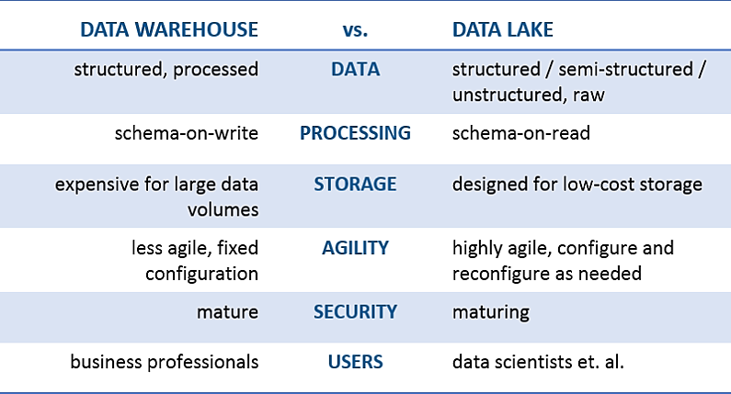
Structured DW vs Unstructured

